Slide 1
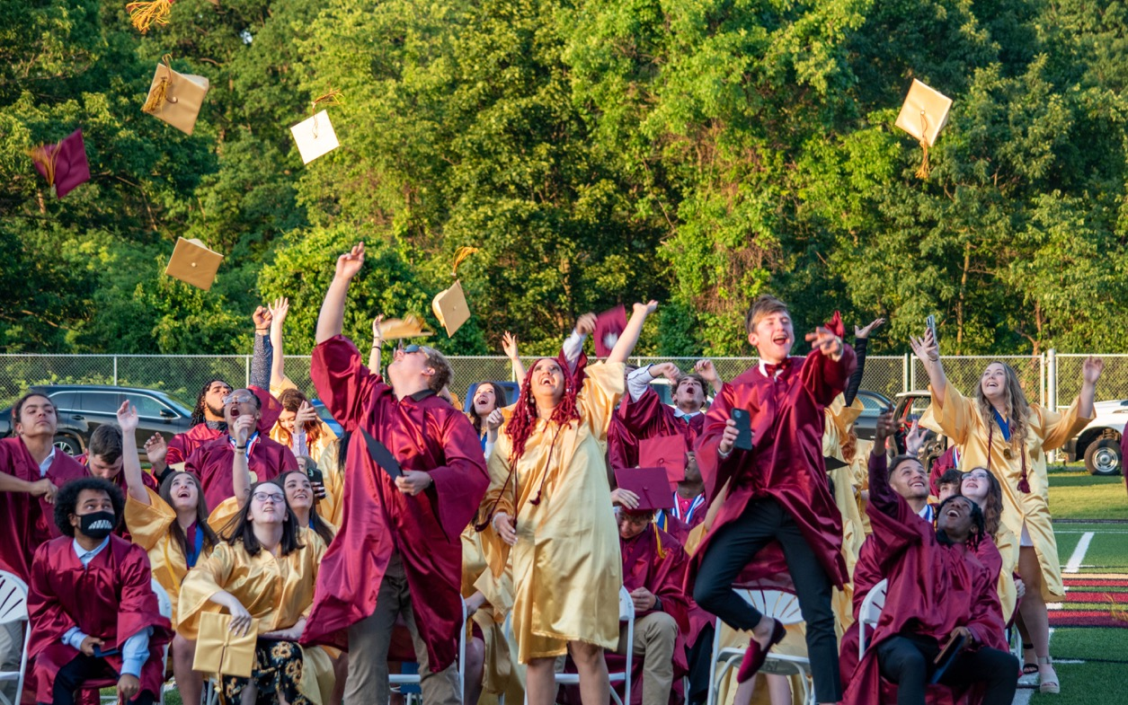
Steel Valley Stronger
Steel Valley School District
Edward Wehrer, Superintendent
December 9, 2021

Slide 2

Steel Valley Stronger: Opportunity Meets Need
The COVID-19 pandemic has reinforced the need for school districts to provide greater support to students and families.
We just shut down Park Elementary for two days because of the outdated infrastructure of a building that was built in 1909.
Current, short-term funding is available to help address student and family support.
We need to make the long-term commitment to address our facilities needs.

Slide 3
Steel Valley Stronger: Guiding Questions
Five key questions should guide the process as Steel Valley builds for the future.
Who are we?
Where are we?
Why do we exist?
What are we going to do?
How do we do it?

Slide 4
Steel Valley Stronger: Who are we?
Our identity is reflected in our core values.
  Currently, we have 25 belief statements listed on our website, but no core values
District staff members are working to identify collective core values.
As a starting point, I recommended these core values:
  Our diversity is our greatest asset
  Each student has needs
  Each student has strengths
  We are responsible for everyone’s welfare
  Ironmen Pride is real

Slide 5
Steel Valley Stronger: Where Are We?
We have an opportunity with federal funding through the American Rescue Plan Elementary and Secondary School Emergency Relief (aka, ARP ESSER III).
7% of the money must be used for designated purposes such as addressing learning loss, but we have approximately $4.6 million to spend between
now and September of 2024.
We face a threat from a budget deficit of roughly $3 million.
We have charter school expenditures of approximately
$7 million.
We have to be fiscally prudent, and we need to
outperform our competition.

Slide 6
Steel Valley Stronger: ARP ESSER III Money
7% Set Aside
  $56,000 for after school academic programs
  $56,000 for summer school
  $278,000 for learning loss (additional kindergarten teacher at Barrett, materials for reading support, and additional Success Coach time)
Possible other expenses
  Significant one-time costs, such as a new reading series
  Social-emotional learning curriculum
  Continuing operations

Slide 7
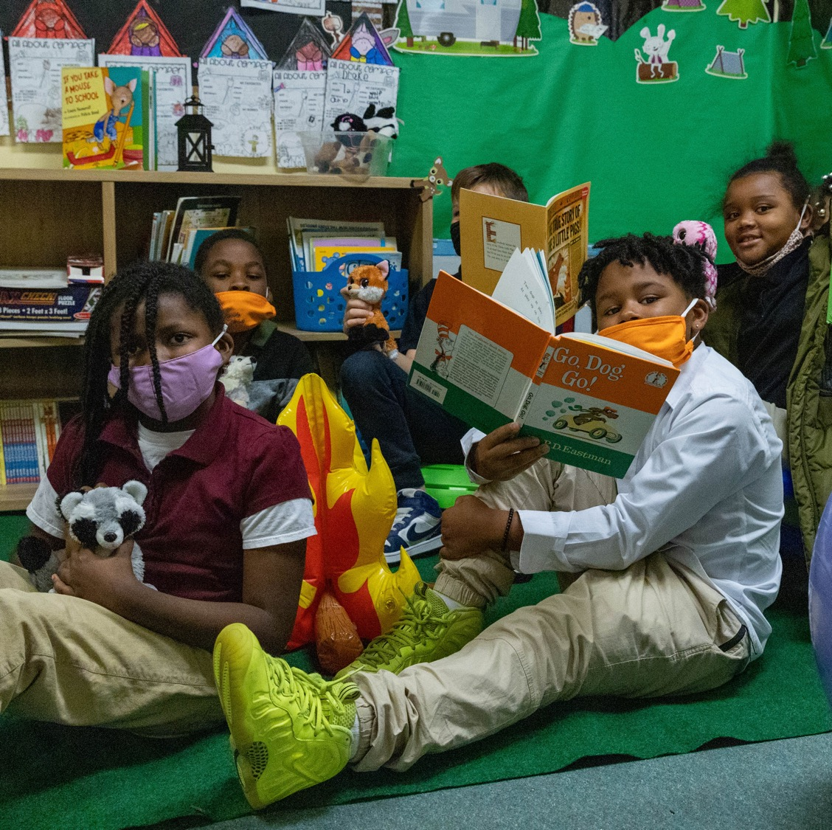
Steel Valley Stronger: Why Do We Exist?
Our Mission: All of our people are healthy and thriving, which means that we have Healthy and Thriving Schools
Our Vision: By 2025, all of our elementary students learn together in a new building

Slide 8
Steel Valley Stronger: Our Mission
Mission: All of our people are healthy and thriving
Who does that include?
  All of our stakeholders, but particularly students and staff
Healthy how?
  We emphasize health from a physical, mental, emotional, social, economic and civic perspective
Thriving students
  Learning at or above grade level
  Understanding and managing emotions and relationships
  Developing the skills and planning necessary for career success

Slide 9
Steel Valley Stronger: Our Vision
Our Vision: By 2025, our elementary students learn together in a new building
How do we justify two elementary schools with such stark racial, socioeconomic and performance differences in a district of roughly four square miles?
Just this week, the age of Park Elementary has
disrupted our students’ education.
We have commissioned a Feasibility Study by
VEBH Architects for a new K – 4 elementary school
on the Campbell Campus.

Slide 10
Steel Valley Stronger: Our Vision
What happens to the current buildings?
Barrett will be used for central office functions and non-traditional learning. Classrooms in the main building will be rented to Pre-K programs.
  Classrooms in the Campbell Addition will be used for healthcare services for our students, families and community.
Park will be demolished with the land used for
development or sold for renovation into housing.
  The building will not sit vacant.
Franklin may need to be torn down as part of the
new-school construction project.

Slide 11
Steel Valley Stronger: Our Vision
What are the benefits?
All K – 4 learners will have a state-of-the-art educational environment.
  2-story Library/Media Center
  2 STEAM/Innovation Centers
  Small-group instructional areas
All students in grades K – 12 will learn together.
Transportation for students in grades K – 8.
We are investing in the futures of our community
and our families.

Slide 12
Steel Valley Stronger: New Elementary School Draft Design

Slide 13
Steel Valley Stronger: Our Vision
What are the costs?
~$32 million for the school
~$500,000 per year for transportation
How will this be paid for?
Borrowing (we continue to pay for the High School)
Building Campaign
New development; every $10 million in real estate value
provides $250,000 in tax revenue
  Woodlawn property
  Old driving range property
  Park school property
Student recruitment; every charter school student costs an average of $20,000 per year
Staff attrition through retirements

Slide 14
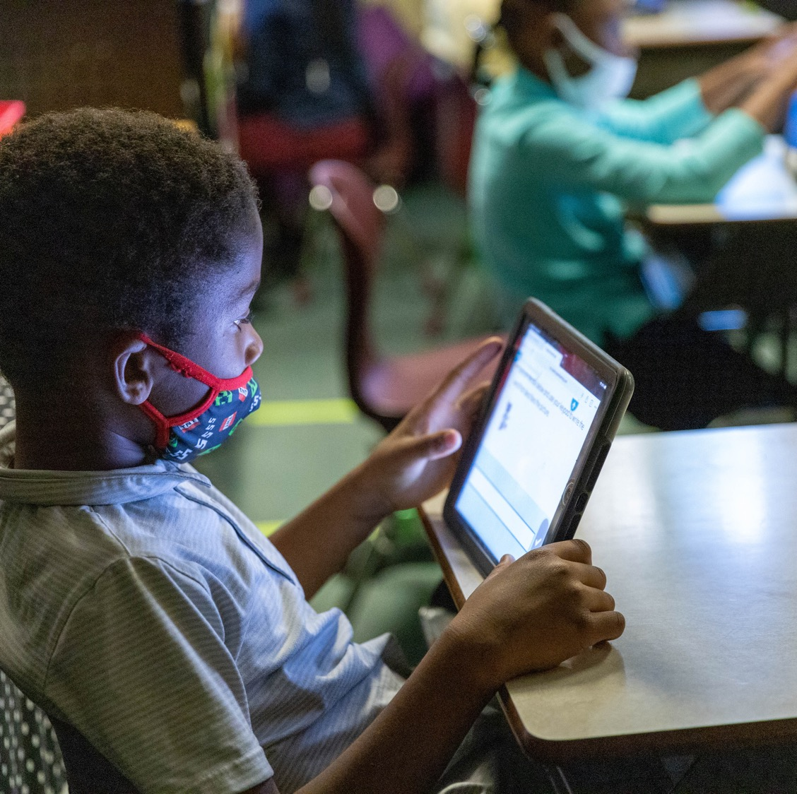
Steel Valley Stronger: Planning
A new school is only one component of Steel Valley Stronger. The four main areas of focus are:
  Academics
  Health
  Equity and Inclusion
  Careers

Slide 15
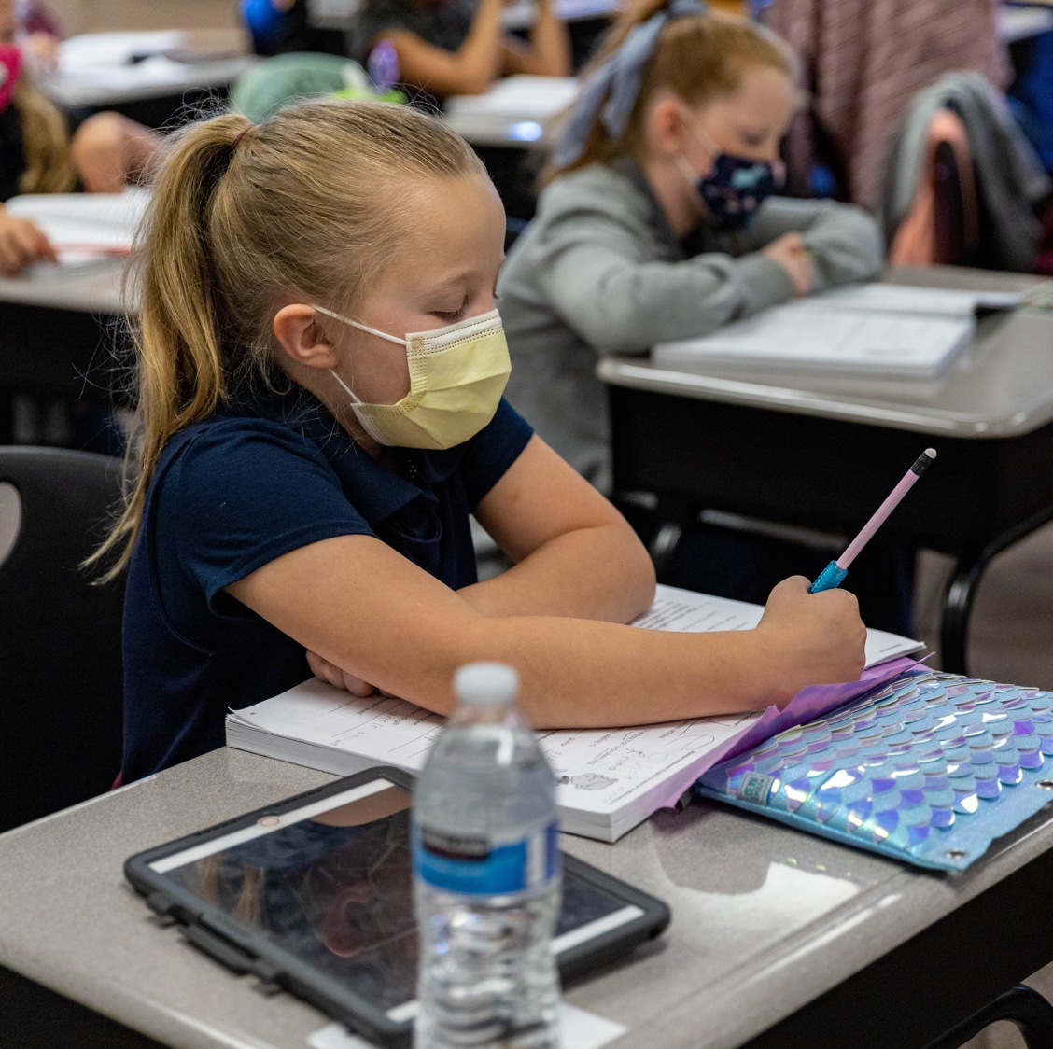
Steel Valley Stronger: Academics
Multi-tiered system of support
Curricular alignment between elementary schools
Curricular alignment with state standards
Focus on students with IEPs, with emphasis on Least Restrictive Environment in classrooms and disproportionality in discipline
Led by Mr. Macuga, Dr. Shaughnessy and Ms. Bragan

Slide 16
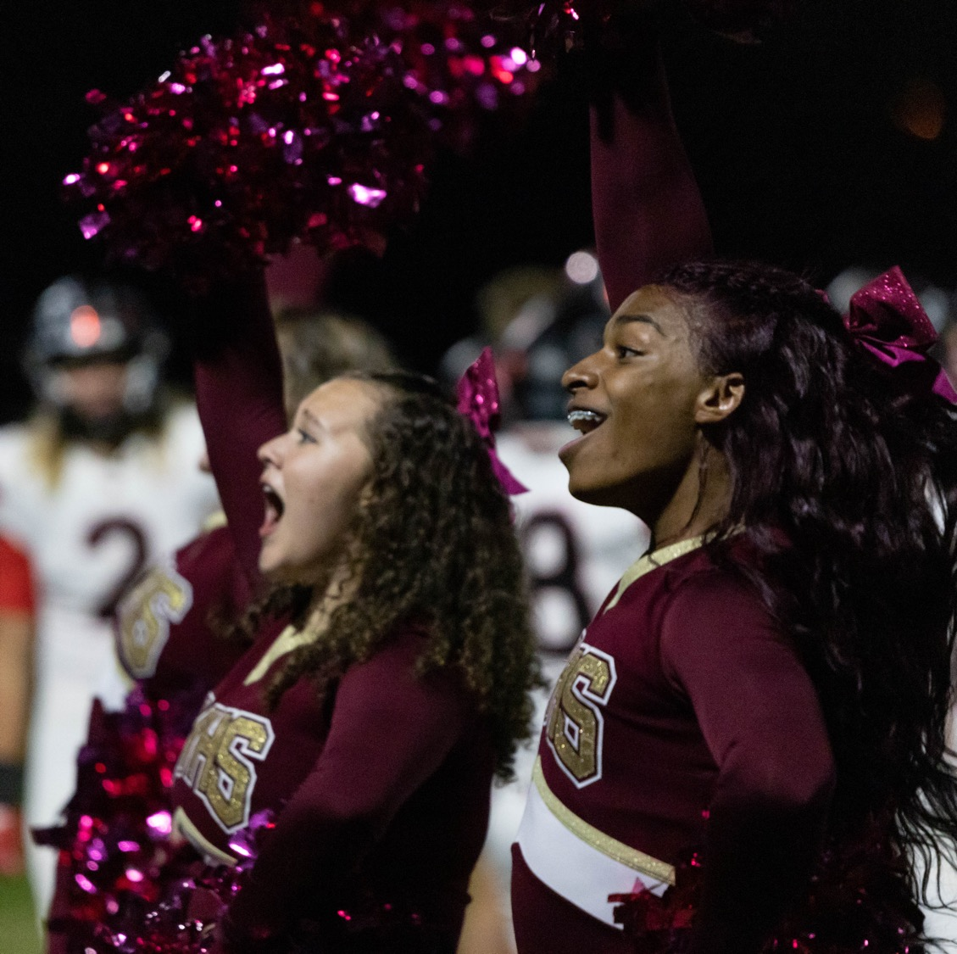
Steel Valley Stronger: Health
Multi-tiered system of support
Strong partnership with UPMC Children’s Hospital of Pittsburgh
Adoption of our version of the Whole School, Whole Community, Whole Child (WSCC) from the Centers for Disease Control
Led by Dr. Mumau and Mr. Walsh

Slide 17
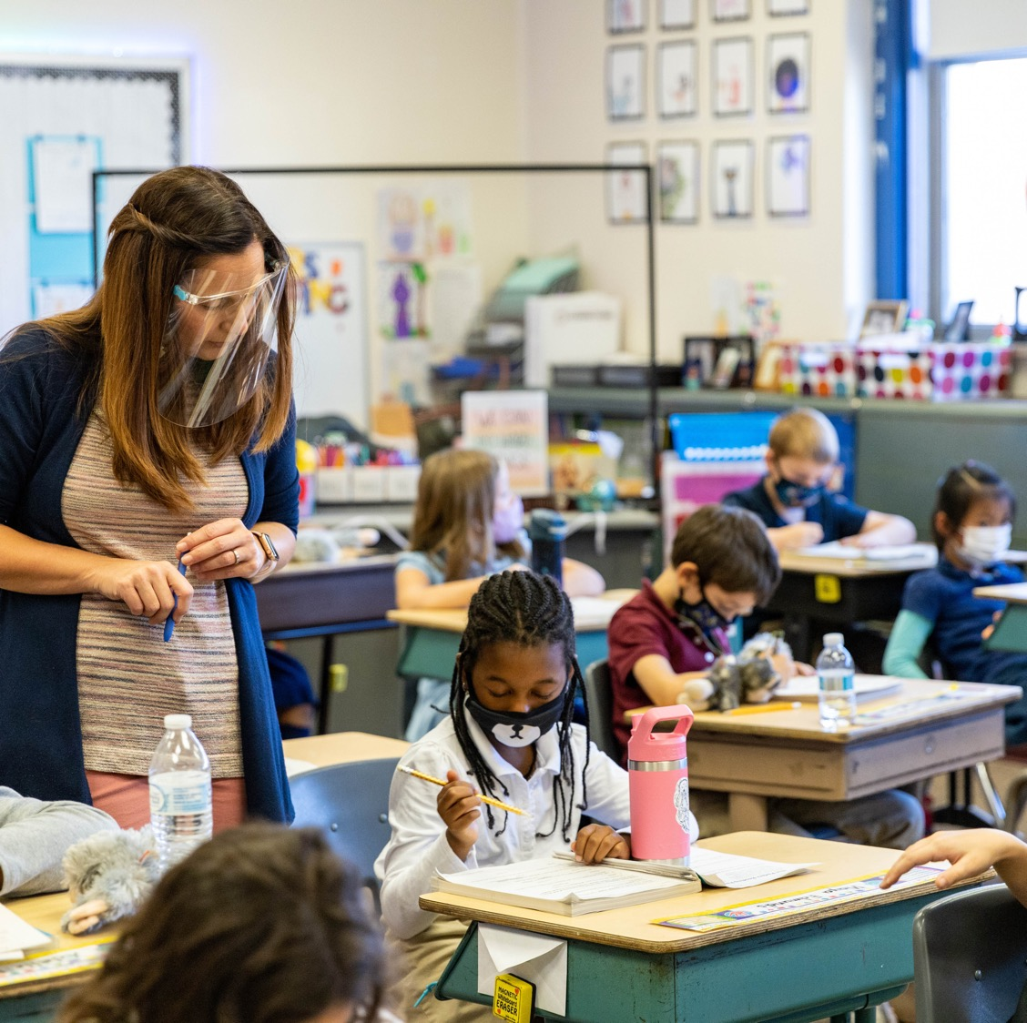
Steel Valley Stronger: Equity and Inclusion
Multi-tiered system of support
Leveraging the resources of outside agencies to meet the specific needs of each of our students
Addressing our greatest local and national challenge
Everything we do needs to be viewed through the lens of equity
Led by Mr. Dulin and Mr. Strom

Slide 18
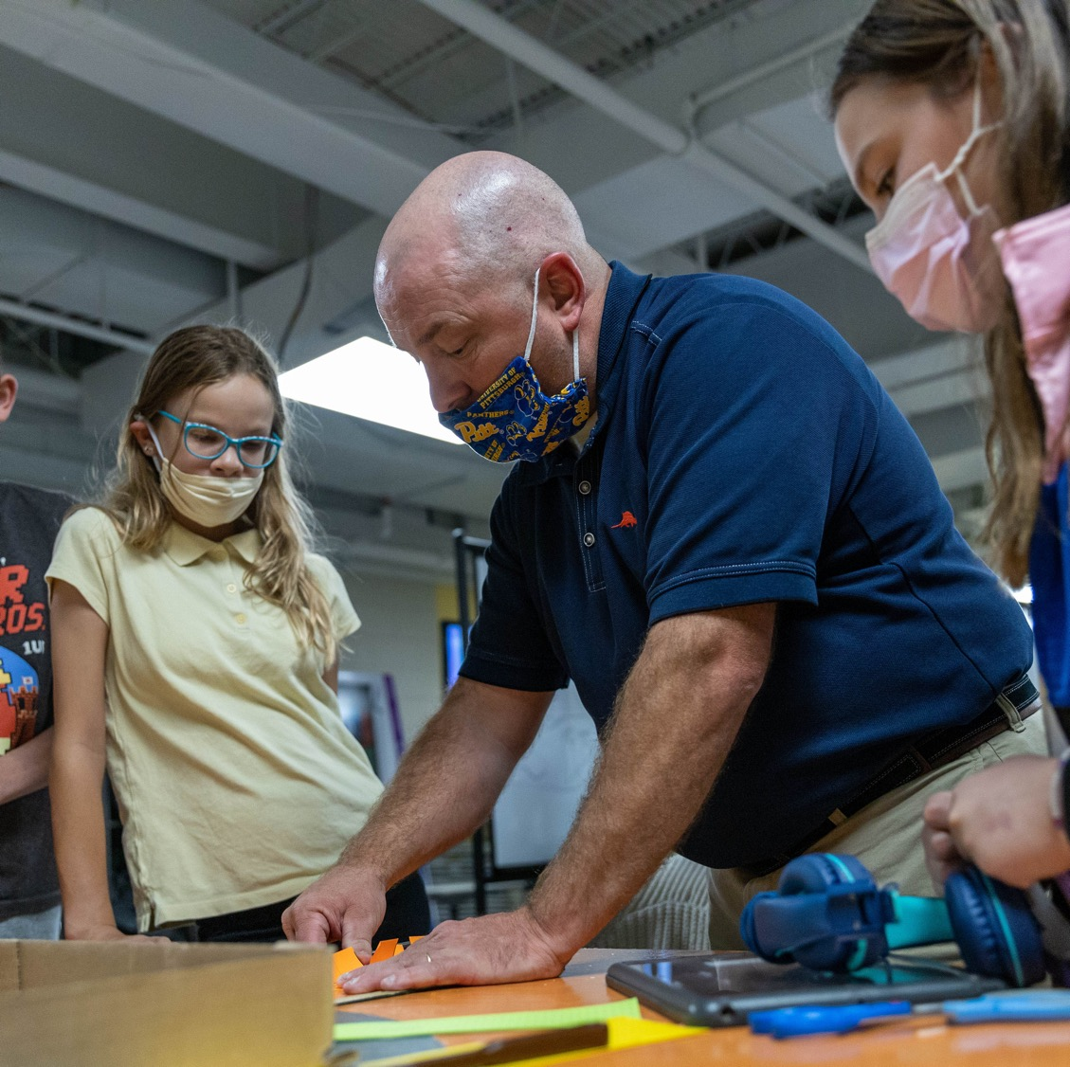
Steel Valley Stronger: Careers
Multi-tiered system of support
Create a credential system that recognizes when a student has the requisite skills for career success
Continued work with partners like PNC and their Partner Up program and The Consortium for Public Education and their Future is Mine program
Incorporated as part of Phase 2

Slide 19
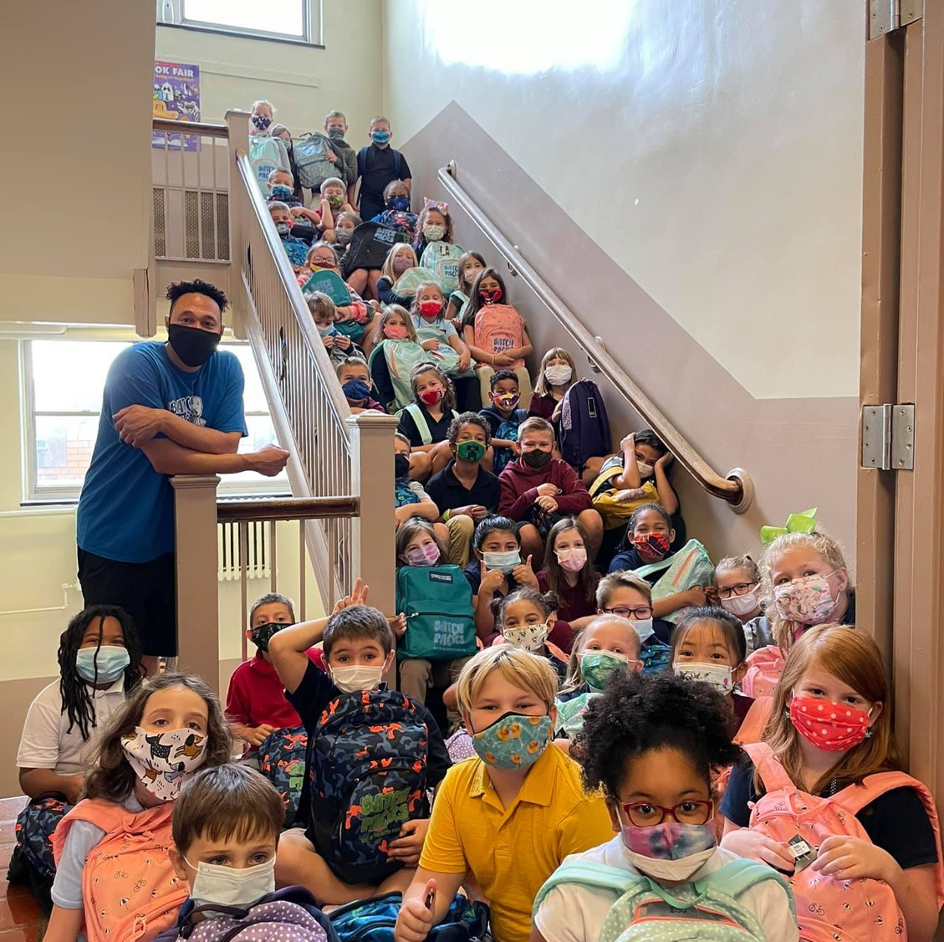
Steel Valley Stronger: Execution
How do we do it?
Five key ingredients:
  Internal expertise
  Shared leadership
  Valued partners
  Teamwork
  Maximized resources

Slide 20
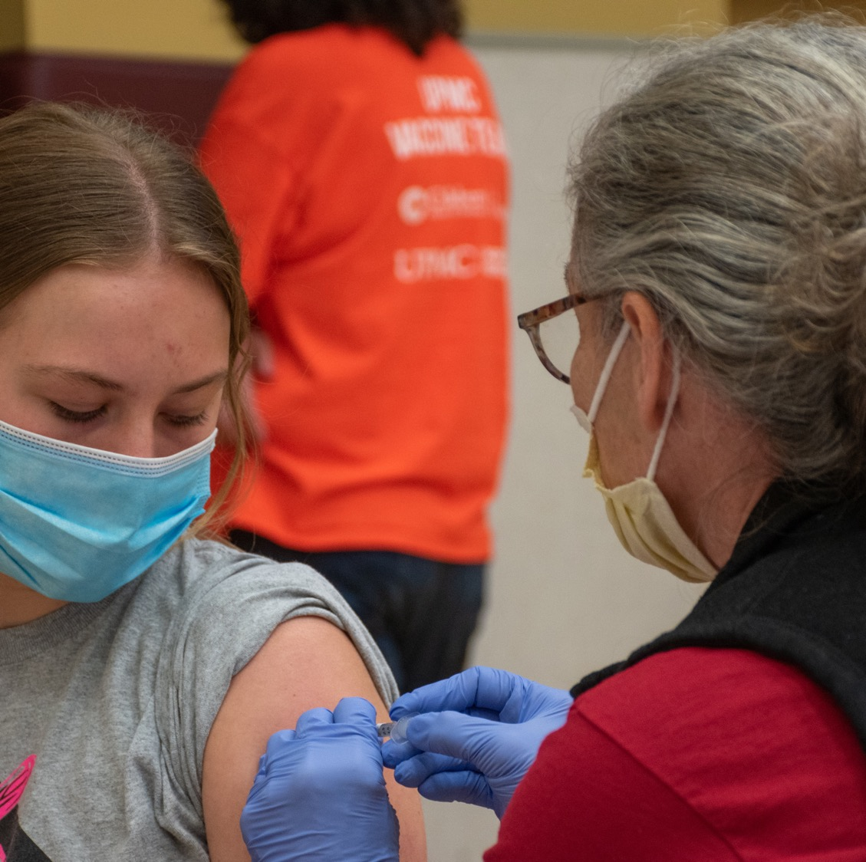
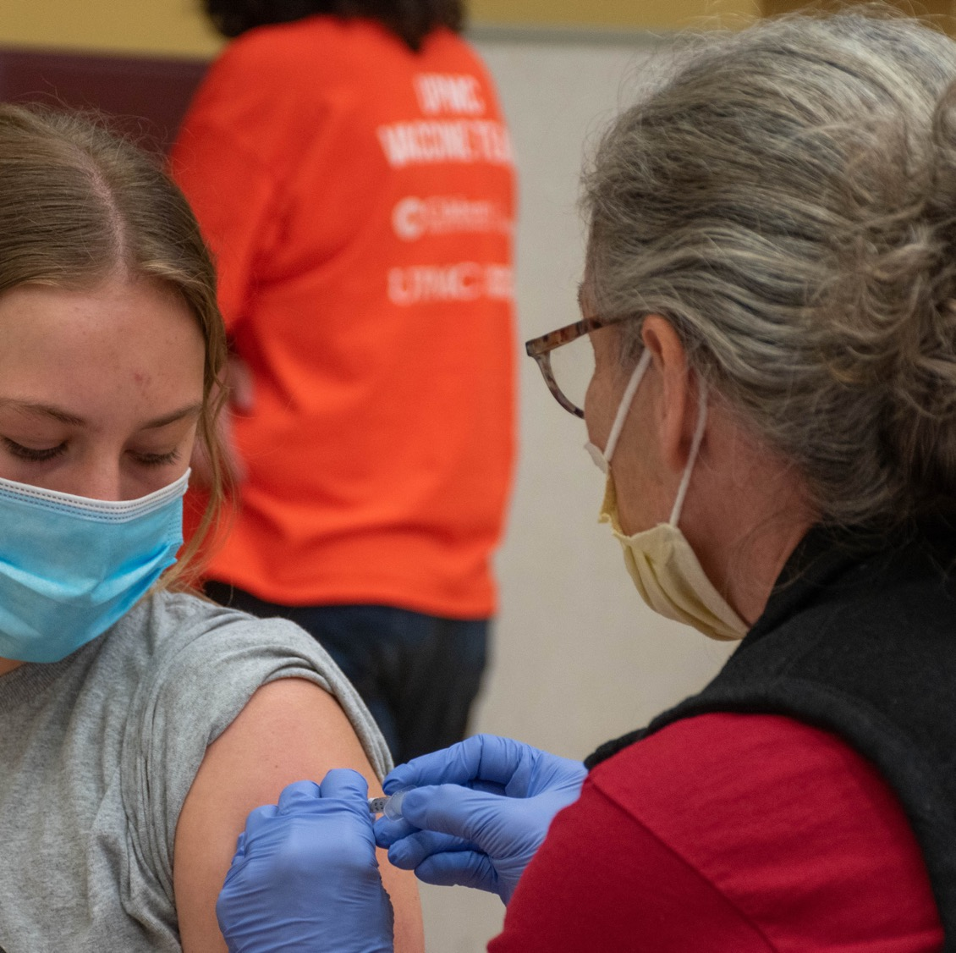
Steel Valley Stronger: Execution
How do we do it? We already have been:
Hiring of Ms. Bragan, Mr. Dulin and Dr. Mumau
Vaccine clinics with UPMC
Programs such as Partner Up, Expect Respect and the 3Rs
COVID leave for vaccinated employees
Alignment of elementary curriculum
Feasibility study with VEBH
Least Restrictive Environment with MS Emotional Support classroom
Partnerships with the AIU, UPMC, PNC and the Consortium for Public Education
Recruitment of 20 charter students during the summer of 2021

Slide 21
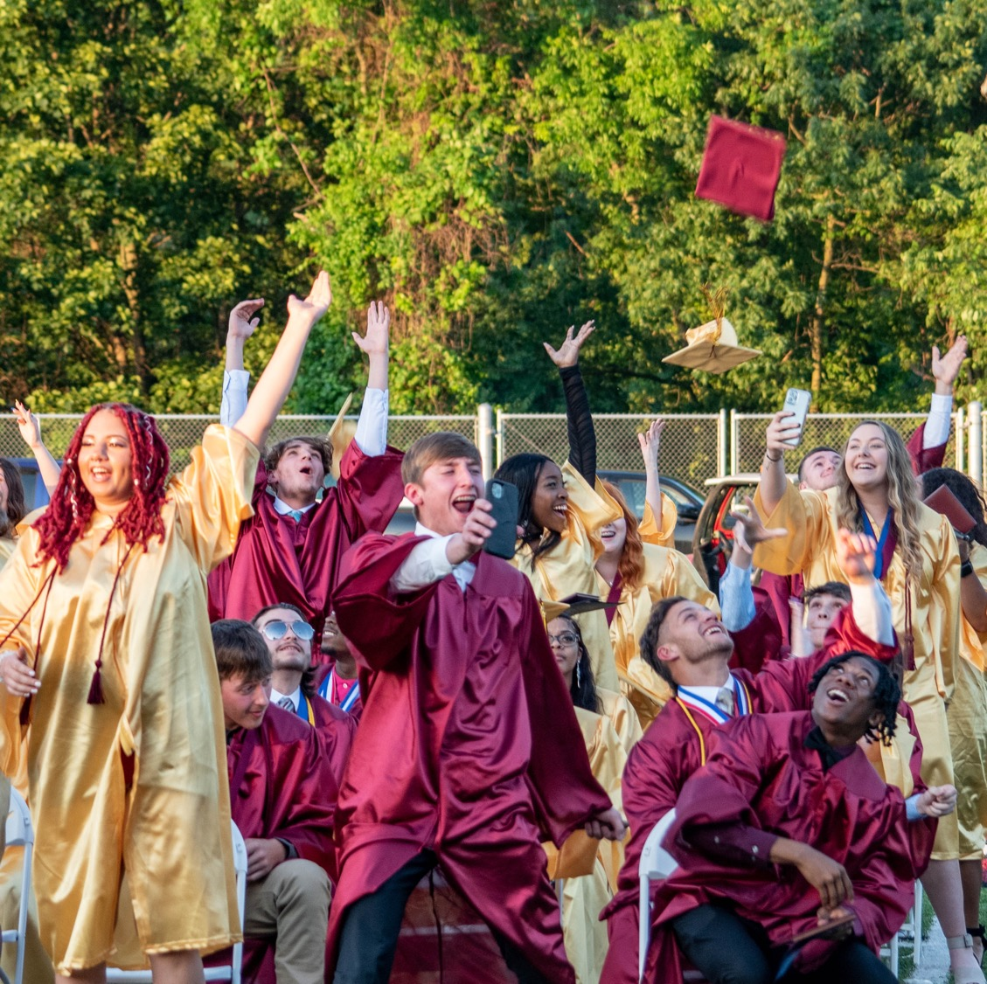
Steel Valley Stronger: Execution
We have an opportunity to redefine Steel Valley for the next 10-25 years.
With the support of our families and community, Steel Valley will be Stronger!

Slide 22
Steel Valley Stronger

