Slide 1

2023-2024 Proposed Final Budget
Steel Valley School District
Matt Weber, Treasurer
May 25, 2023

Slide 2

Highlights
Proposed increase of 3% Millage from 26.8913 to 27.6980
Proposed budget deficit of $228,329
Total Revenue: $44,798,047
  Total increase of ~$3.2M from 22-23 Budgeted Revenues
  Increase in State Subsidies of ~$2.7.M
  Increase in Other Income ~$.4M for insurance claim
Total Expenditures: $45,026,377
Total increase of ~$2.8M from 22-23 Budgeted Expenditures
  Salaries increased ~1.2M due to raises and maintaining ESSER III positions
  Health Insurance Rate Increase of 14% ~$.9M
  Facility cost ~.5M (repairs, utilities, supplies)
  Debt Service payments increased ~$.3M

Slide 3
County 22-23 Millage Information

Slide 4
County 22-23 Millage Information Cont’d

Slide 5
Significant Expenditure Breakdown
Charter School Costs budgeted $.5M decrease ($6.4M to $6.2M)
  Current year charter enrollment dropped about 10% from 21-22
  PDE form 363 allows for removal of federal funds when calculating per student cost for charter tuition and 23-24 has significant increase due to ESSER funding
  Continue outreach efforts to the community
Salary Costs increased across all categories
  Instructional salaries increased .6M
  Support salaries increased .5M
  Other flat at $.3M
  Increases offset by planned retirements, other departures and ERI
  ERI payouts budgeted at $.8M for 2023-2024
Special Education Costs increased ~$.9M
  Effort to reduce placements in 23-24

Slide 6
Summary
Tax increase of 3% which is significantly lower than current inflation
Additional ESSER Funding allows for significant improvement on budget deficit while still addressing Learning Loss
Charter Costs will be tackled further in 23-24
Cost pressures for Debt Service and mandated costs, such as special education, PSERS and medical costs continue to force tough decisions
Smart cuts are being made across the board, but must continue to right size district staff vs. student enrollment

Slide 7
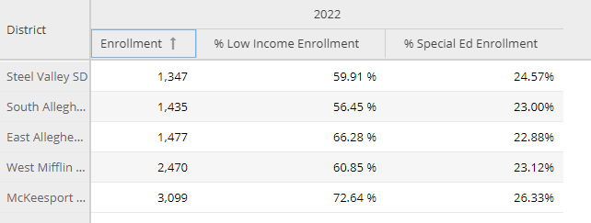
Peer Group 1 – Local Schools

Slide 8
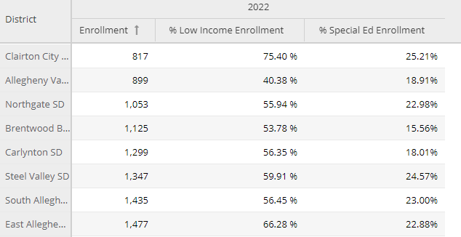
Peer Group 2 – Allegheny County Schools 40 – 80% Low income and 750 to 1950 Enrollment

Slide 9
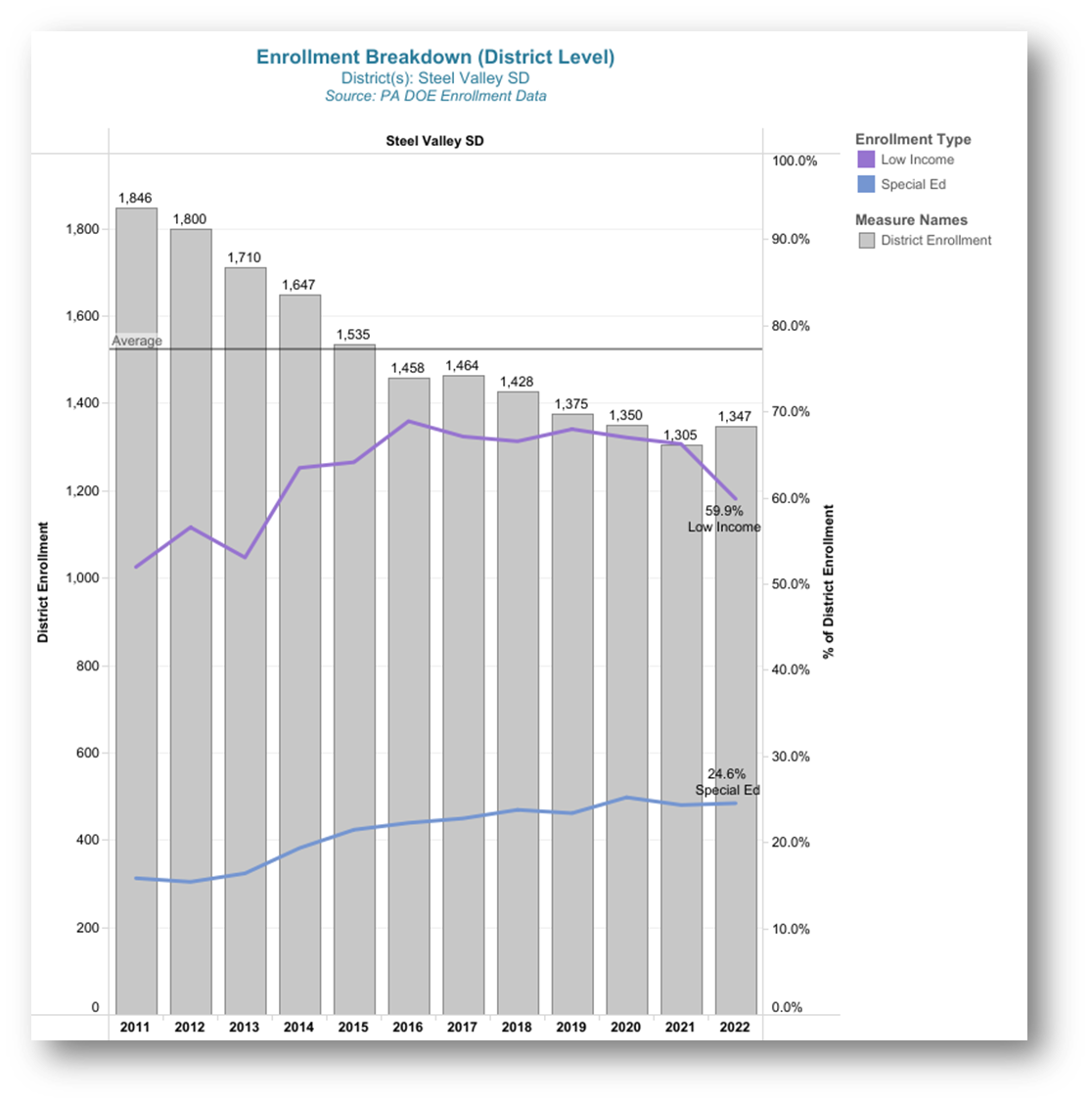
Enrollment History with Low Income% and Special Education %

Slide 10
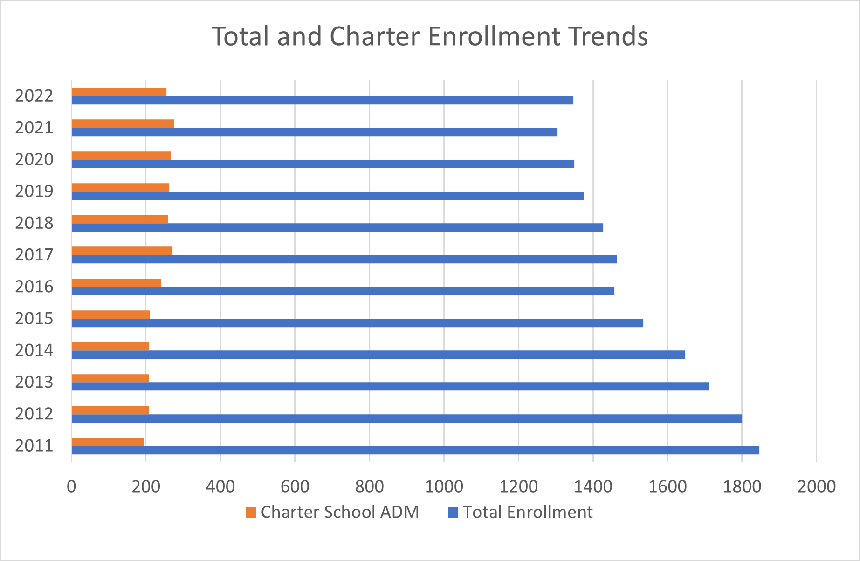
Total and Charter Enrollment Trends
Note – Charter School ADMs not available for all years; estimated based on trends

Slide 11
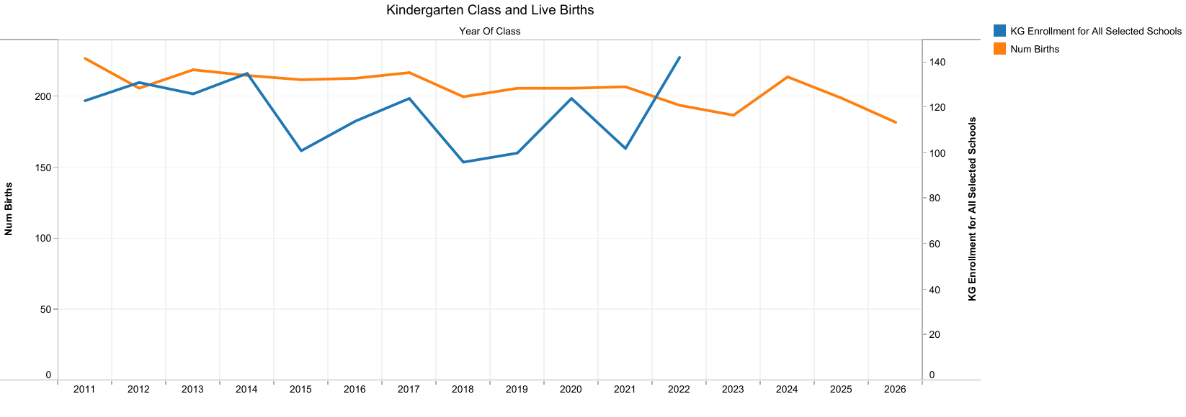
Live Births and Kindergarten Enrollment
Note – Charter School ADMs not available for all years; estimated based on trends

Slide 12
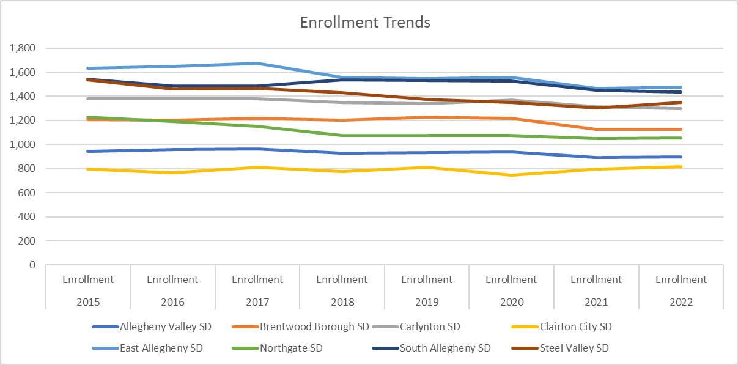
Total and Charter Enrollment Trends

Slide 13
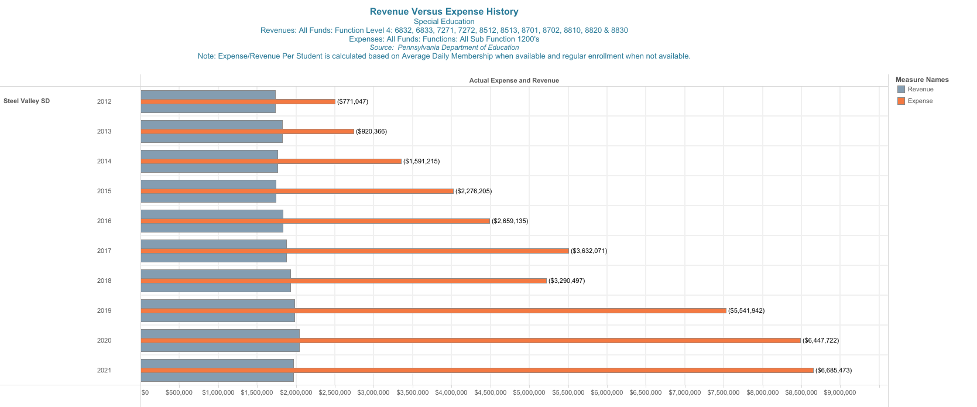
Special Education Revenue versus Special Education Expense

Slide 14
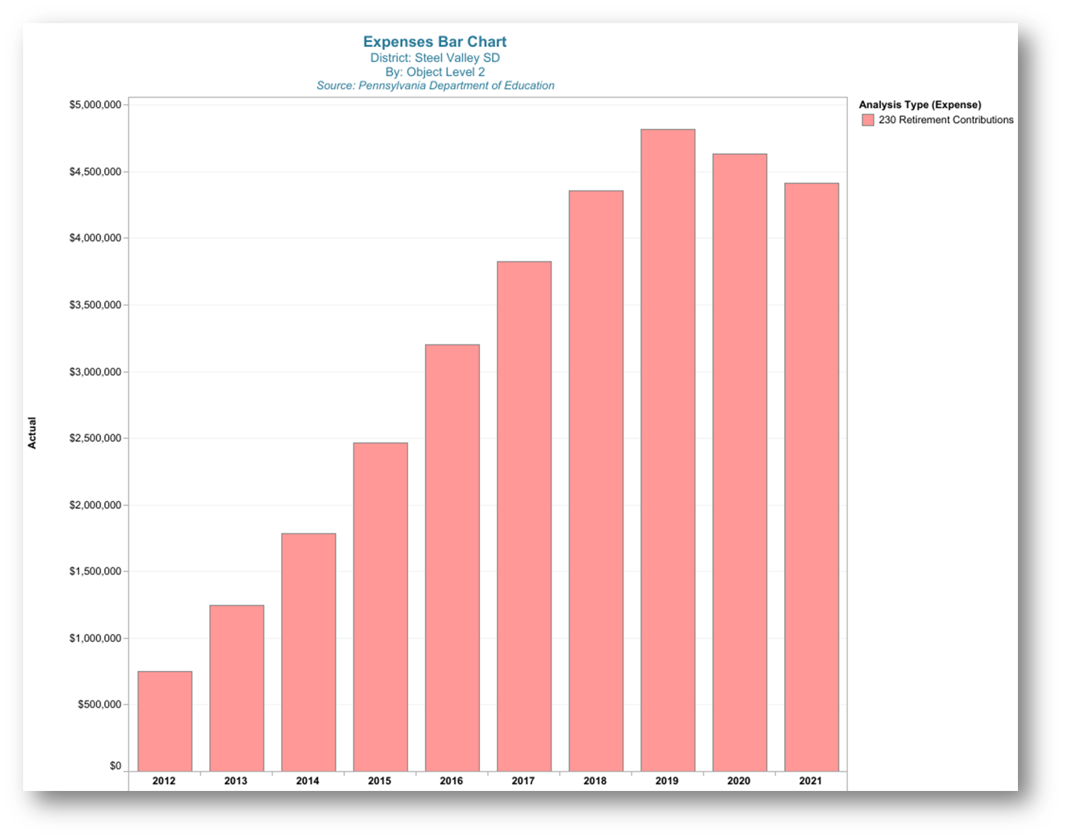
PSERS Expense History

Slide 15
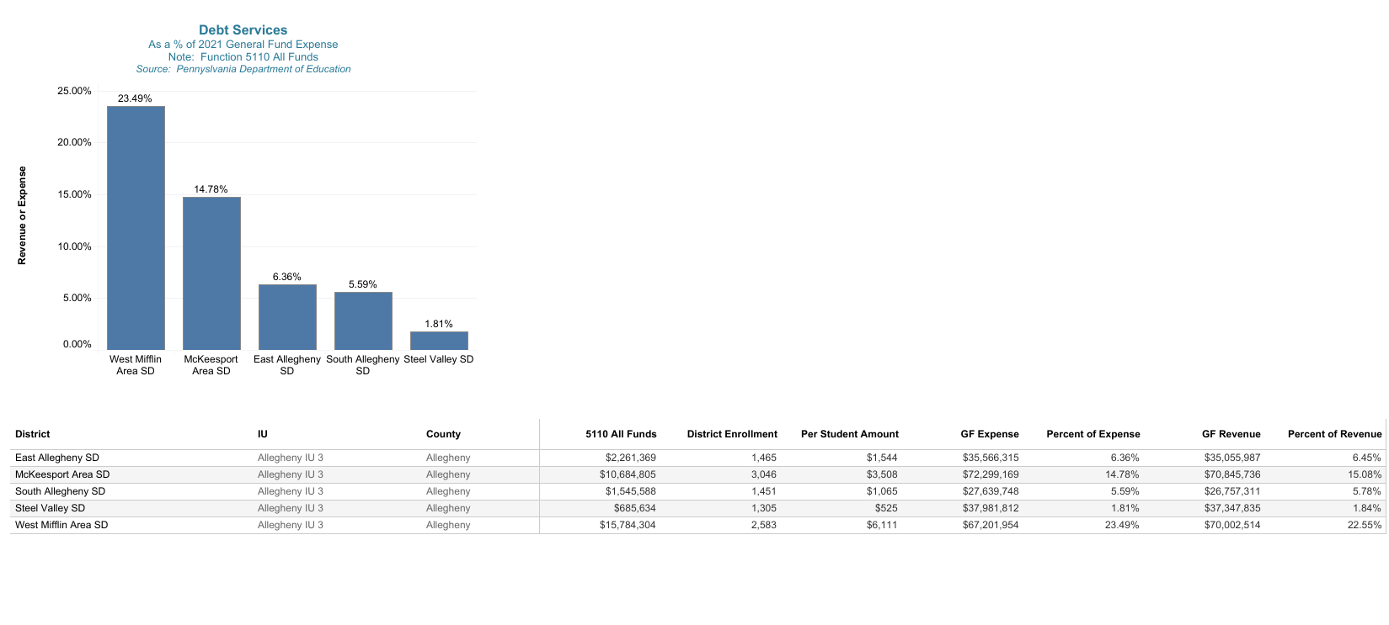
Peer Group Comparison – Peer Group #1
Debt Service

Slide 16
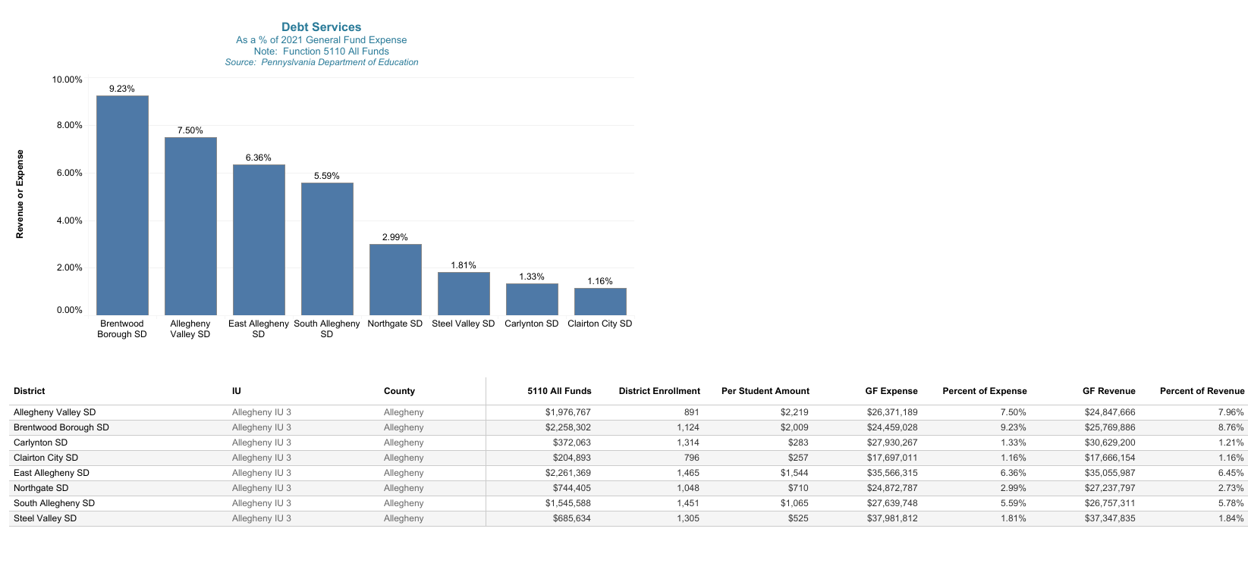
Peer Group Comparison – Peer Group #2 Debt Service

Slide 17
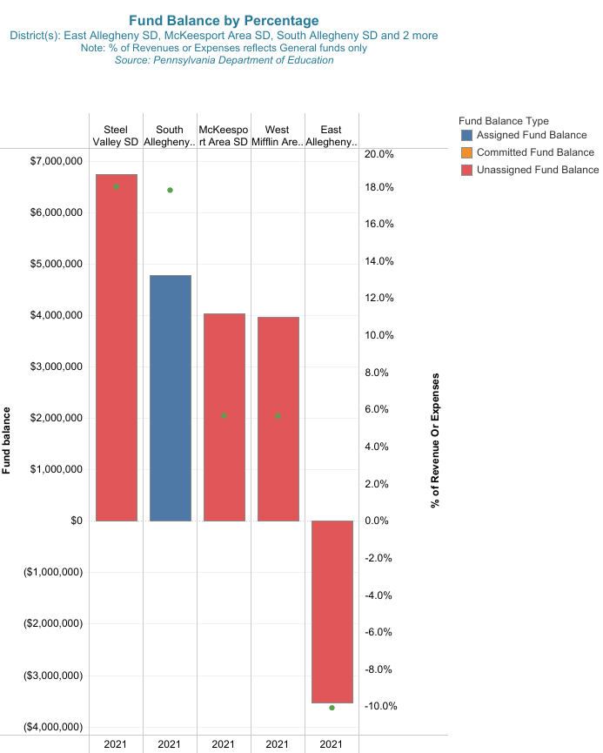
Peer Group #1 Comparison – Fund Balance

Slide 18
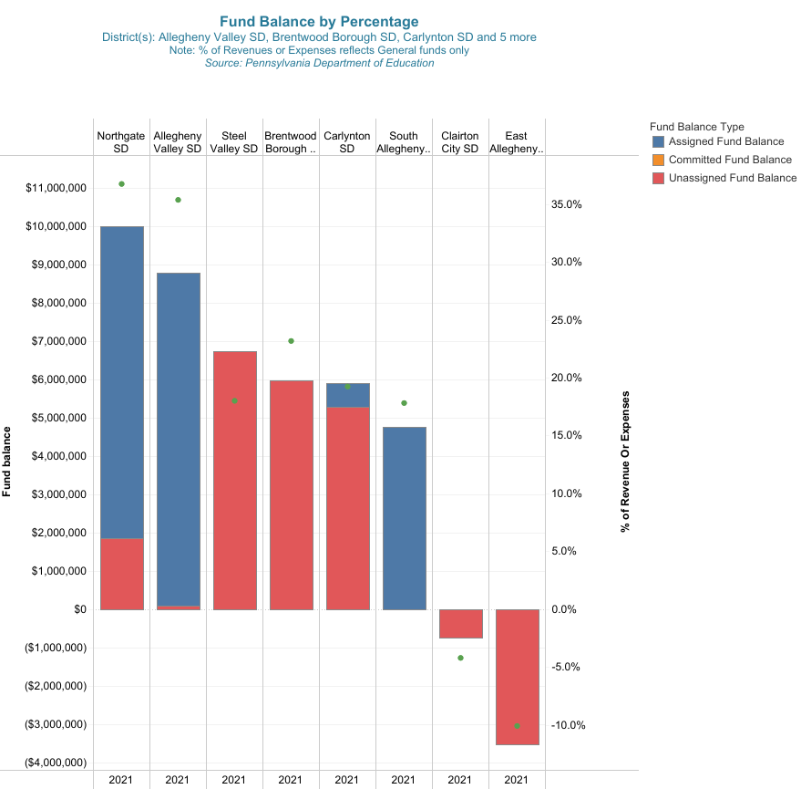
Peer Group #2 Comparison – Fund Balance

Slide 19
Thank you!
#IronmenPride

